Slide 1
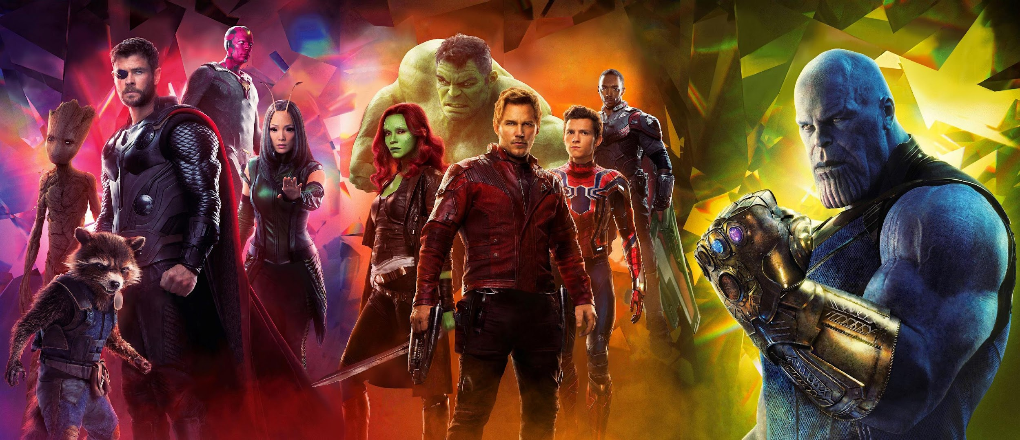
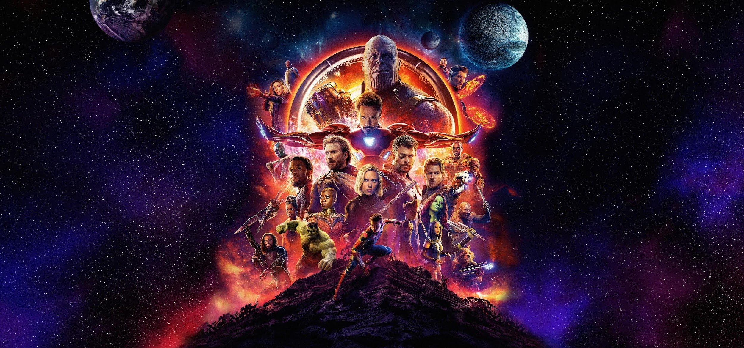
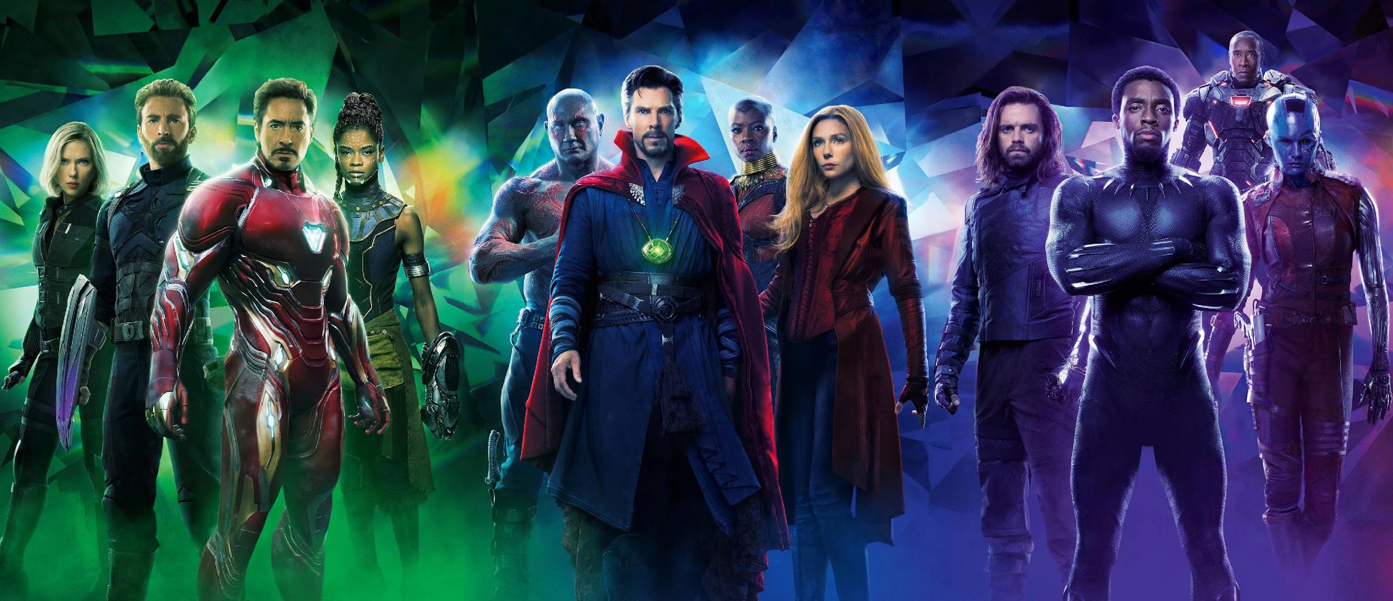
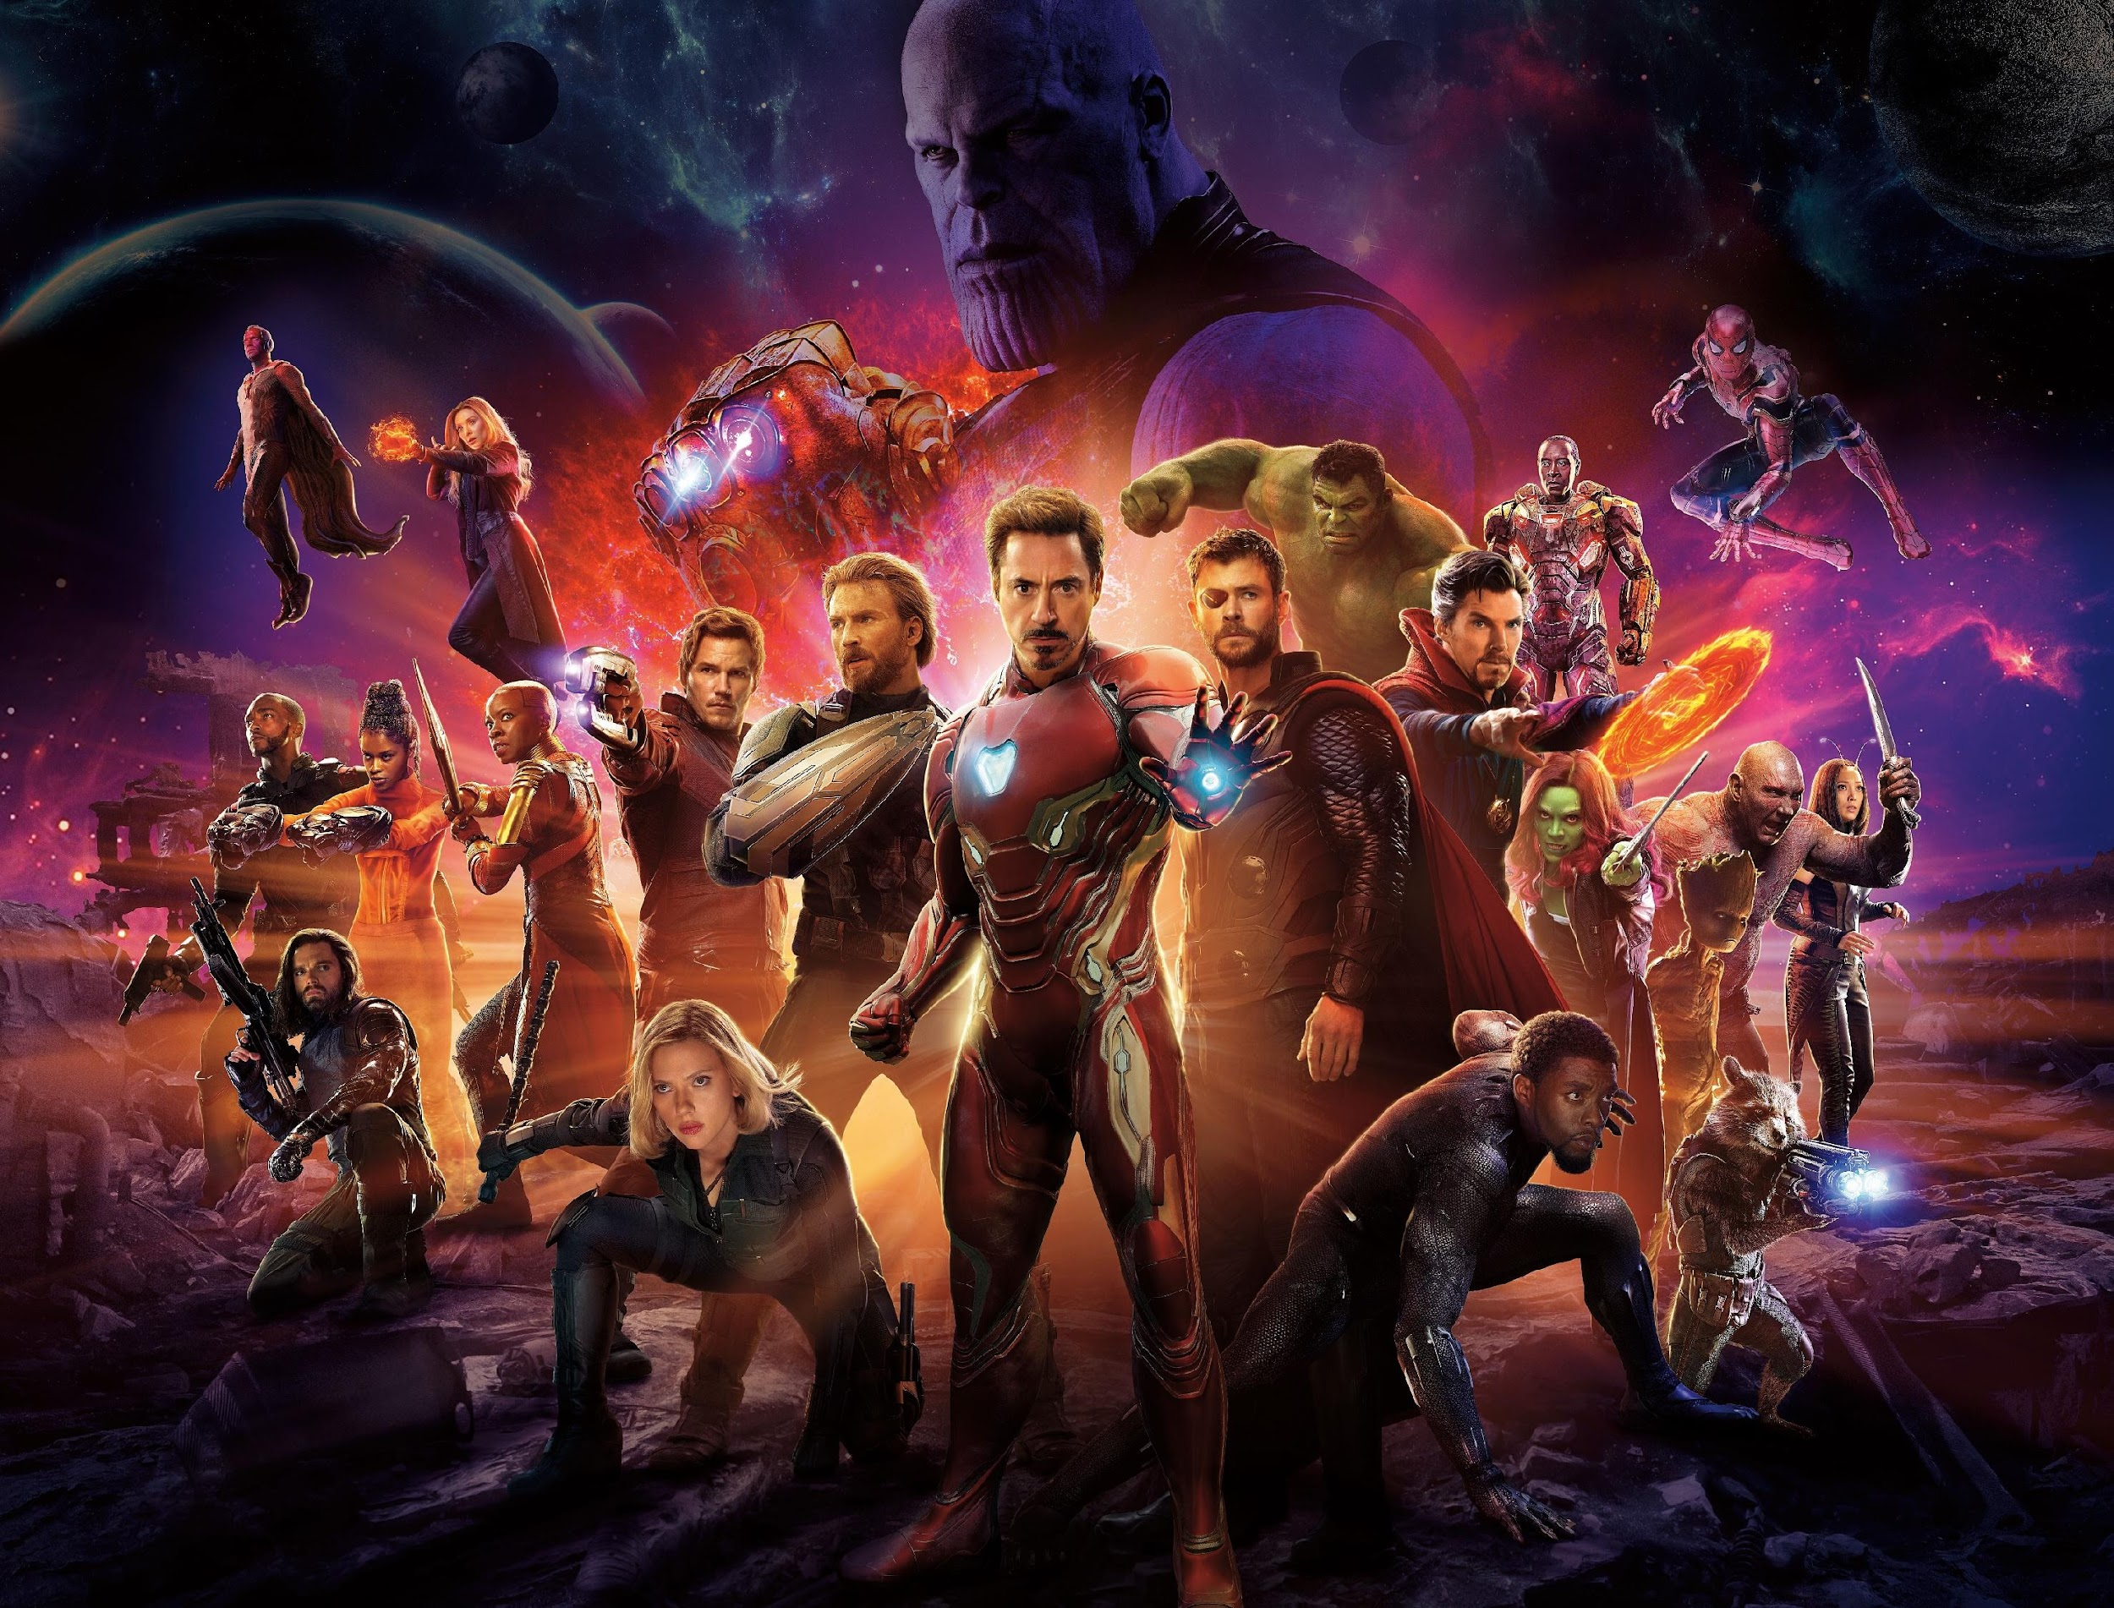

MARVEL
Marvel-ous Insights on Marvel Cinematic Universe
Team 7
Sowmya Kuruba
Madhura Bhatsoori
Pooja Manjunatha
Anitha Balachandran
Nikhil Thota

Slide 2
Introduction & Motives
The Marvel Cinematic Universe (MCU) has become a vast and complex world, encompassing movies, TV shows, comics, and more. This project aims to leverage data visualization techniques to explore and understand the Marvel dataverse comprehensively, providing valuable insights into the key success factors of Marvel franchises, including character popularity, box office revenue, and critical reception.
Marvel enthusiasts and stakeholders, including story writers, production teams, and franchise developers, are often left with unanswered questions about the MCU, which can hinder their ability to engage in meaningful discussions and make informed decisions. Therefore, this project aims to provide comprehensive research and analysis to offer definitive insights into the MCU universe, empowering enthusiasts and stakeholders to gain a deeper understanding of the franchise and make informed decisions based on various aspects of the MCU.

Slide 3
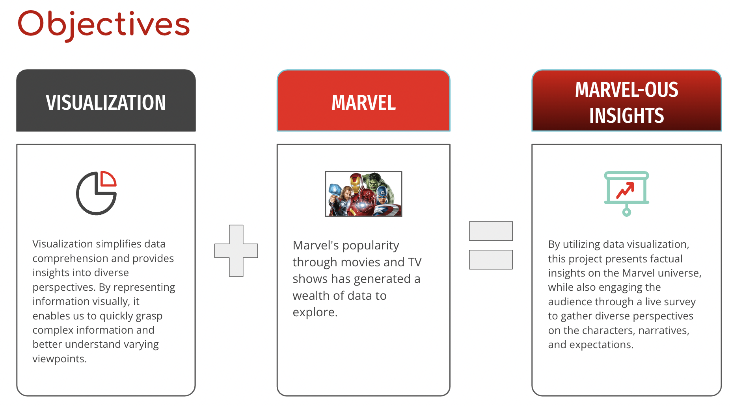
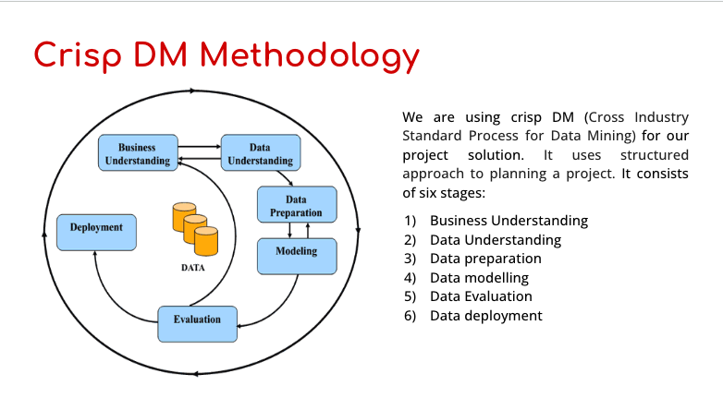
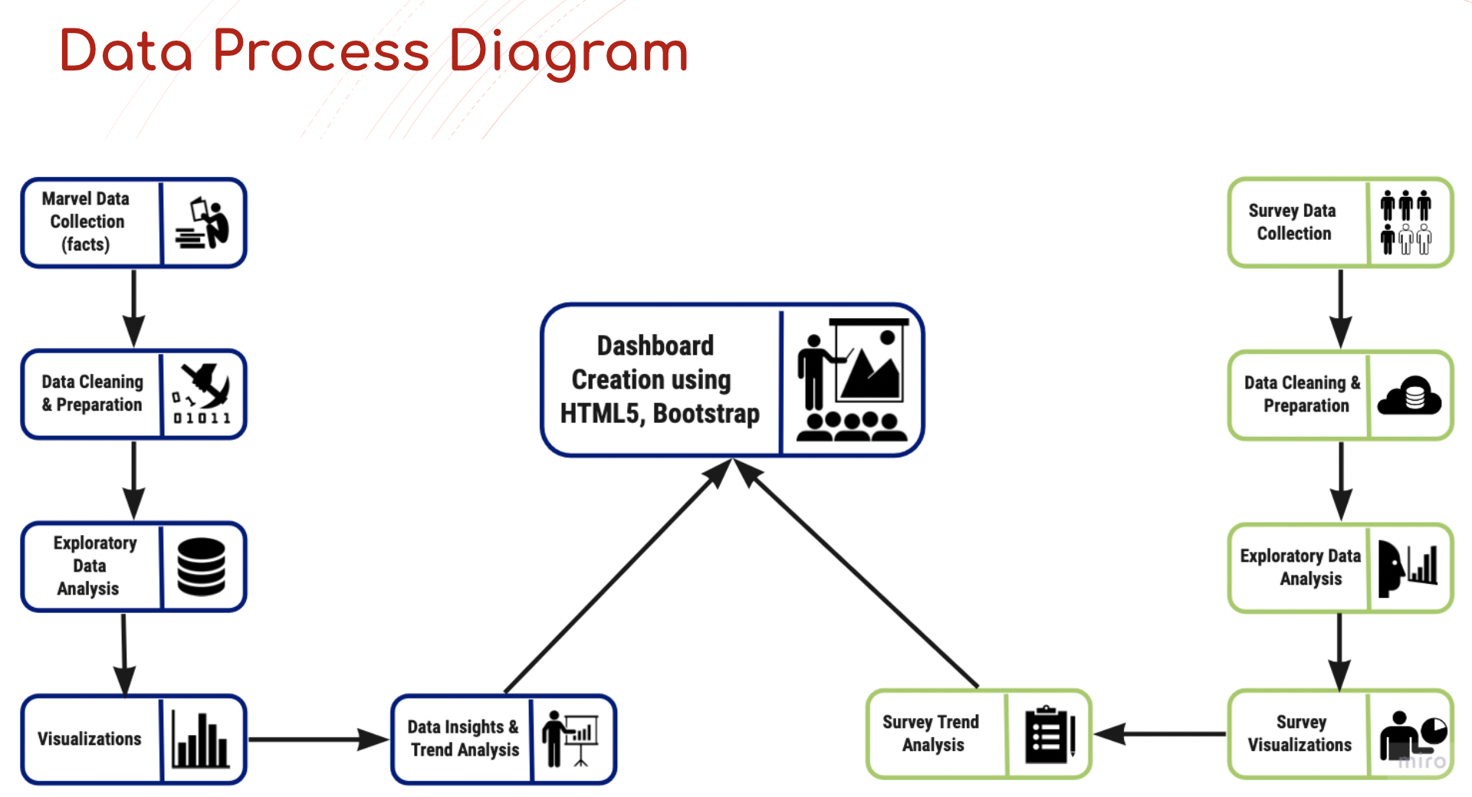
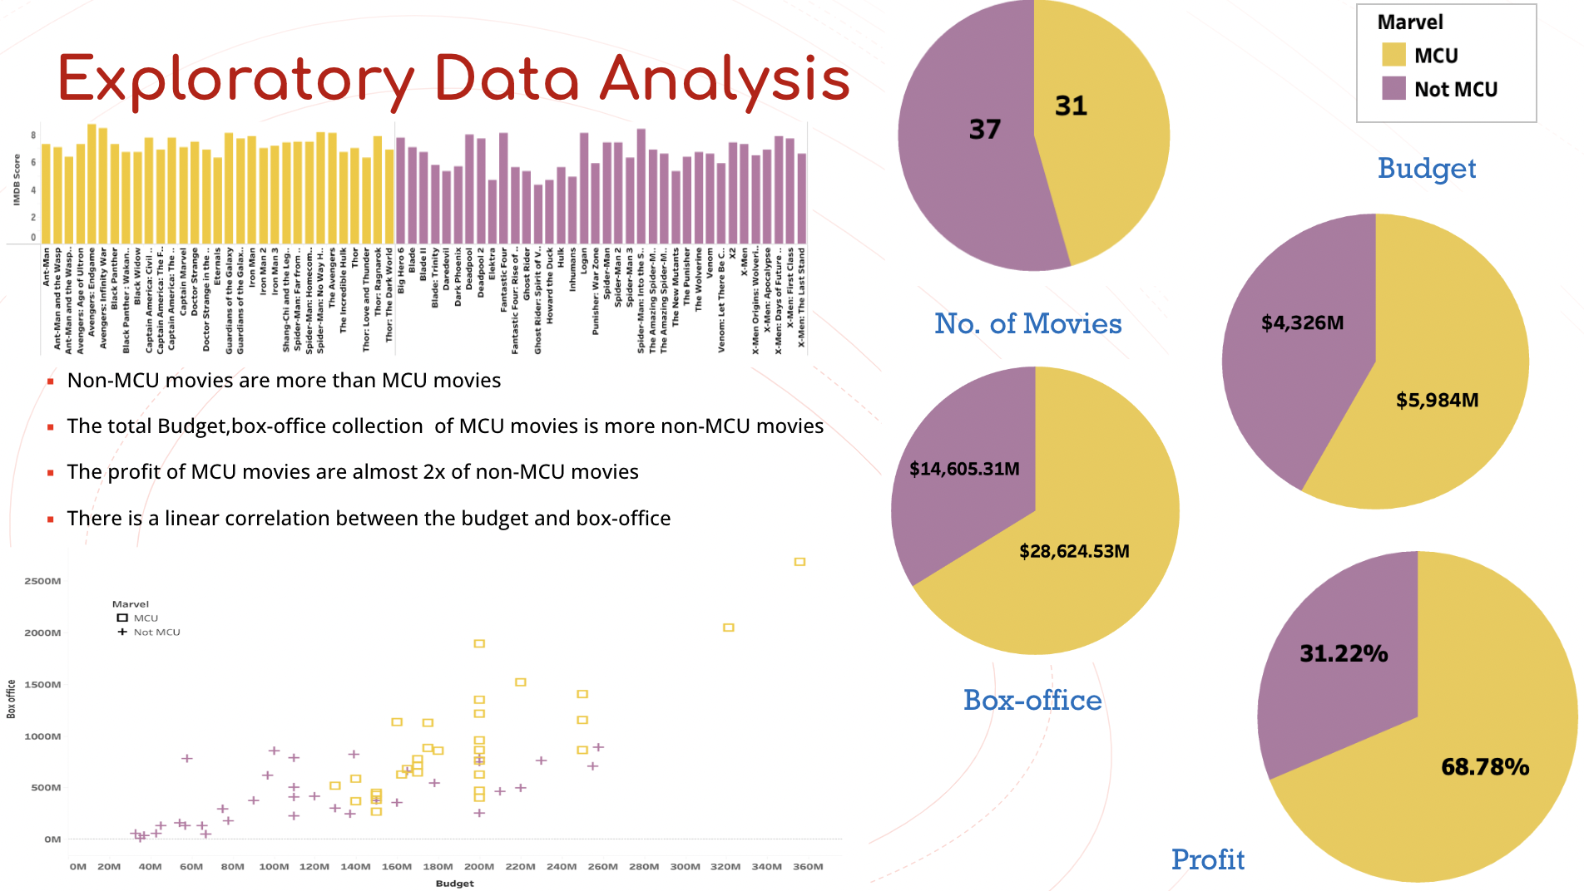
Recap

Slide 4
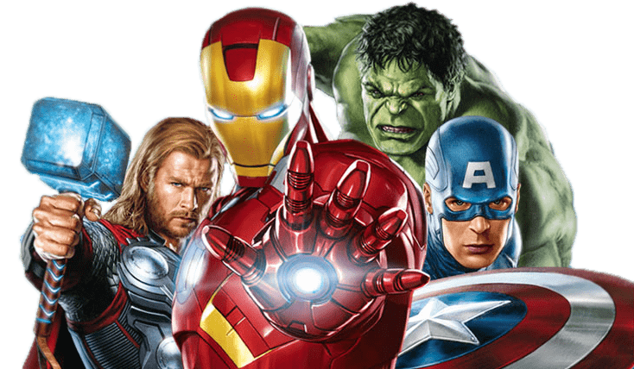
Objectives
VISUALIZATION
MARVEL
MARVEL-OUS INSIGHTS
Visualization simplifies data comprehension and provides insights into diverse perspectives. By representing information visually, it enables us to quickly grasp complex information and better understand varying viewpoints.
Marvel's popularity through movies and TV shows has generated a wealth of data to explore.
By utilizing data visualization, this project presents factual insights on the Marvel universe, while also engaging the audience through a live survey to gather diverse perspectives on the characters, narratives, and expectations.

Slide 5
Literature Survey
Name of the Article | About the Article | How was it helpful in our Marvel project?
The paper by Inseok Ko, and Hyejung Chang, titled "Interactive Visualization and Analysis of Healthcare Data Using Tableau" | The paper highlights Tableau as software that facilitates the exploration and understanding of data through interactive visualizations. | We have drawn inspiration from the concepts and techniques presented in the paper, such as interactive visualizations, customizations, and different chart types, and adapted them to suit the requirements of your Marvel dashboard.
The paper by María Teresa Rodríguez, Sérgio Nunes, and Tiago Devezas titled “Telling Stories with Data Visualization” | The paper aims to inspire further research and emphasizes the value of incorporating storytelling with data in creating engaging and informative experiences. | It can guide the design of effective visualizations for the Marvel project, inspire the incorporation of narrative elements.
The review paper by Jonas Van Der Donckt, Jeroen Van der Donckt, Emiel Deprost, Sofie Van Hoecke titled ” An overview and comparison of free Python libraries for data mining and big data analysis” | The paper recommend: pandas for data preparation; Matplotlib, seaborn or Plotly for data visualization. | This paper offers valuable insights for our Marvel data visualization project by comparing data visualization libraries in Python, and providing recommended libraries for tasks like data preparation and analysis
The paper by Jaehoon Lee, Giseop Noh, Chong Kwon Kim titled “Analysis & Visualization on movie’s popularity and reviews” | This paper focuses on visualization tools that utilize normalized graphs to uncover the underlying moods of movies and illustrate their intricate relationships | This paper on movie analysis and visualization can be useful for your Marvel project by providing insights into the relationship between audience reviews and popularity through visualizations and uncovering the impact.
The article by Louis T. Becker and Elyssa M. Gould titled “Microsoft Power BI: Extending Excel to Manipulate, Analyze, and Visualize Diverse Data” | Introduces Microsoft's Power BI software and its integration with newer versions of Excel, highlighting its potential benefits for librarians in analyzing and visualizing data from diverse sources encountered in library operations | Analyzing and visualizing data related to writer and production survey aspects of the Marvel universe.

Slide 6
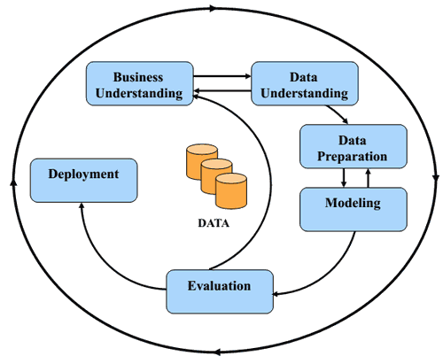
Crisp DM Methodology
We are using crisp DM (Cross Industry Standard Process for Data Mining) for our project solution. It uses structured approach to planning a project. It consists of six stages:
Business Understanding
Data Understanding
Data preparation
Data modelling
Data Evaluation
Data deployment

Slide 7
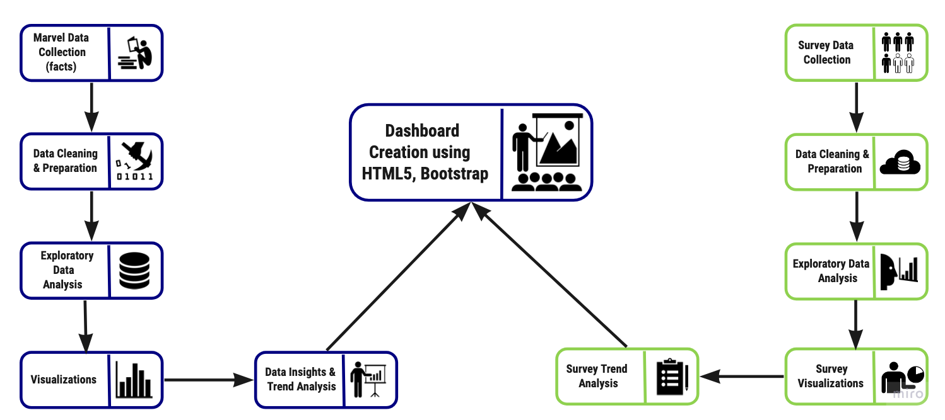
Data Process Diagram

Slide 8
Dataset Description & Collection Methods
Name
Collection Method
Description
Marvel Character Dataset
Marvel API
We used the Marvel API to collect data on various Marvel characters, using Postman.
Marvel Box Office Revenue Dataset
Marvel Movie Rating Dataset
Kaggle
We used Marvel movies revenue and ratings dataset available on Kaggle
Marvel Comic Sales Data
Web Scraping
We scraped data from various websites that track comic book sales from Kaggle and other online resources.
General Audience Survey
Google Forms
We distributed Marvel survey to personal networks and SJSU Sammy App to collect data that helps the Marvel writers and production team.

Slide 9
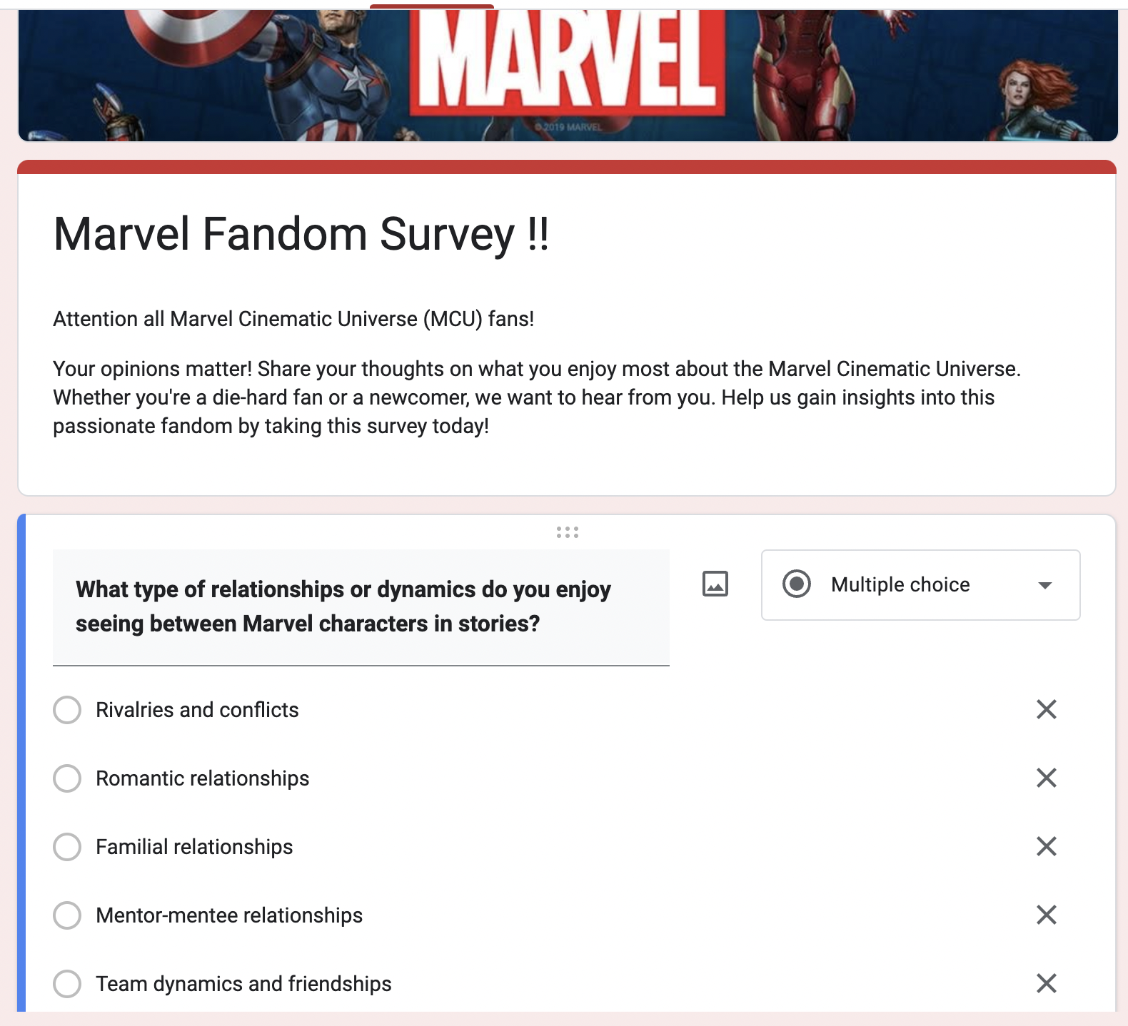
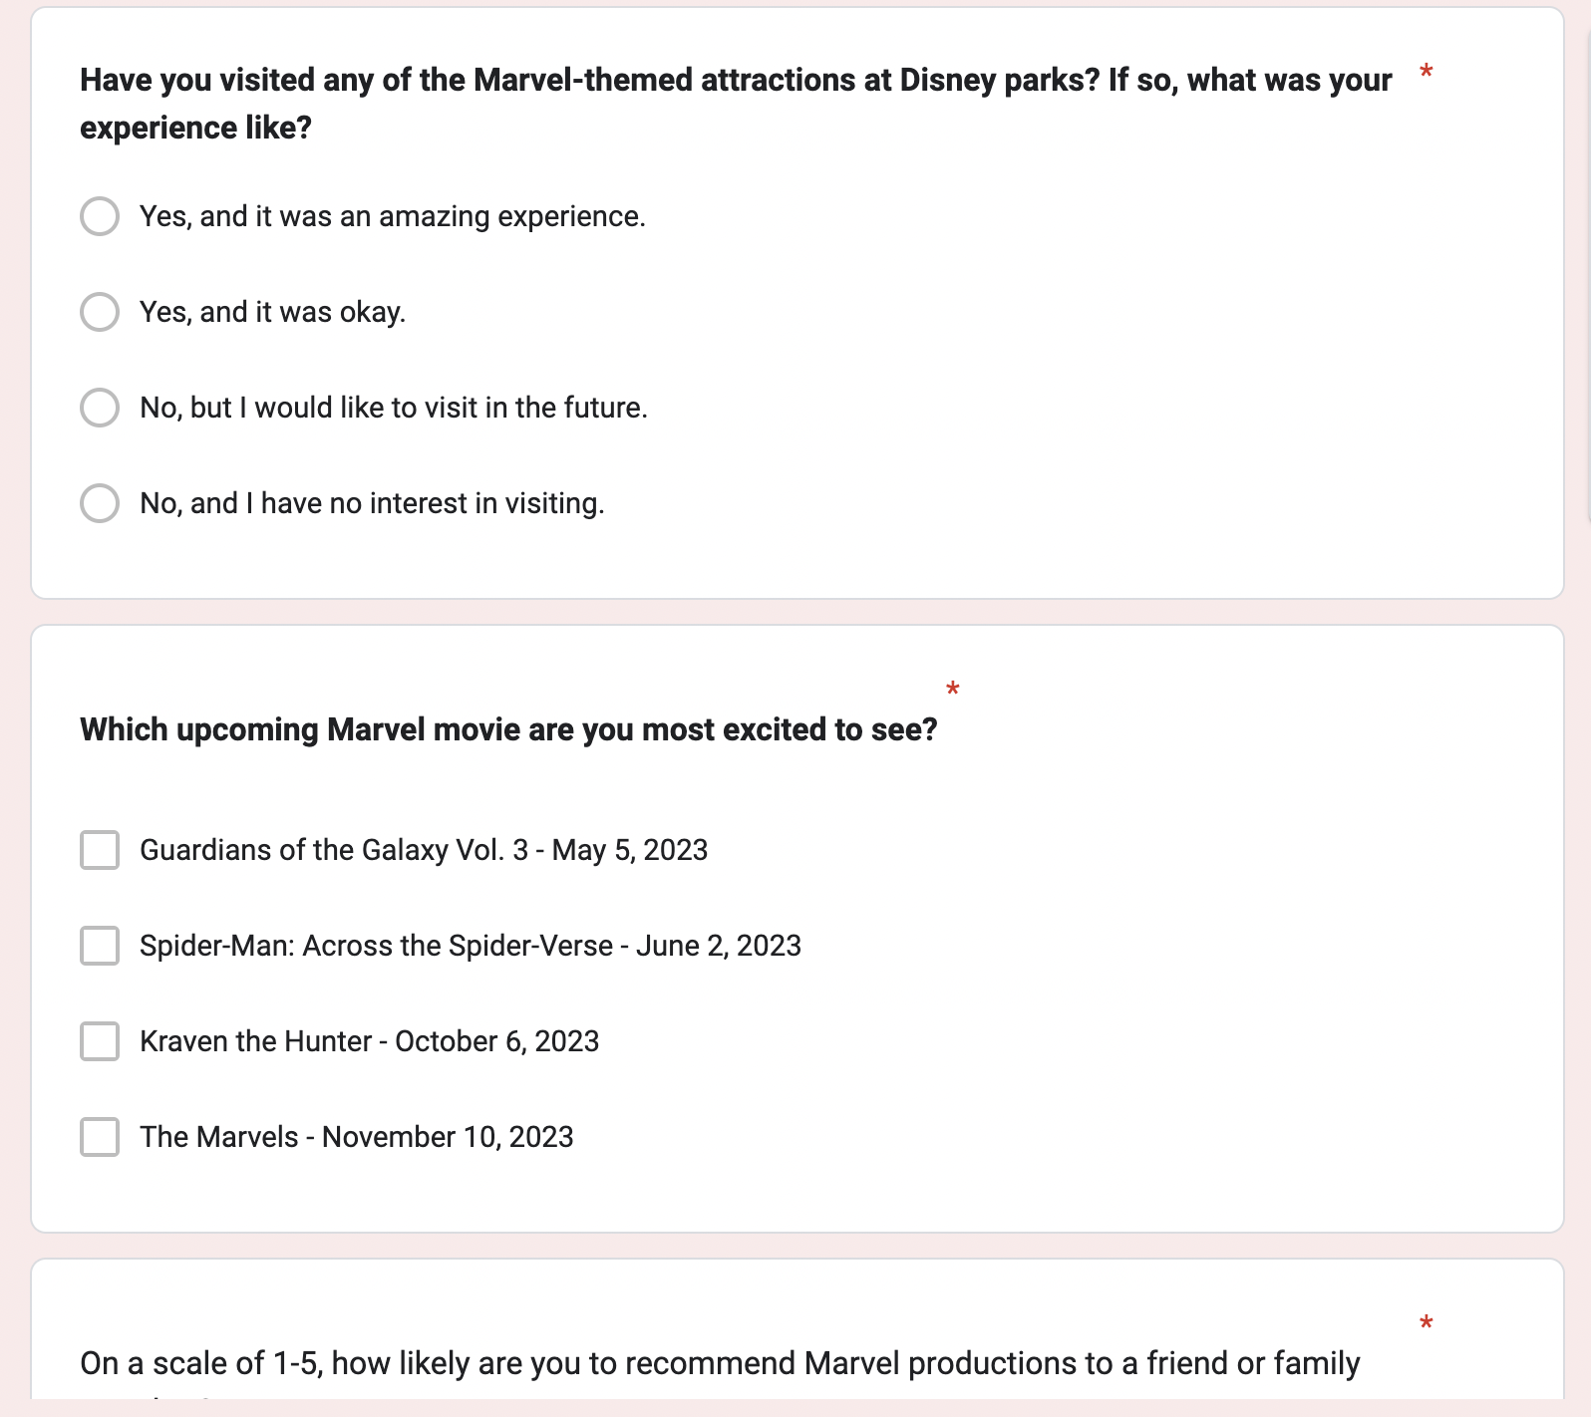
Snapshot of Survey

Slide 10
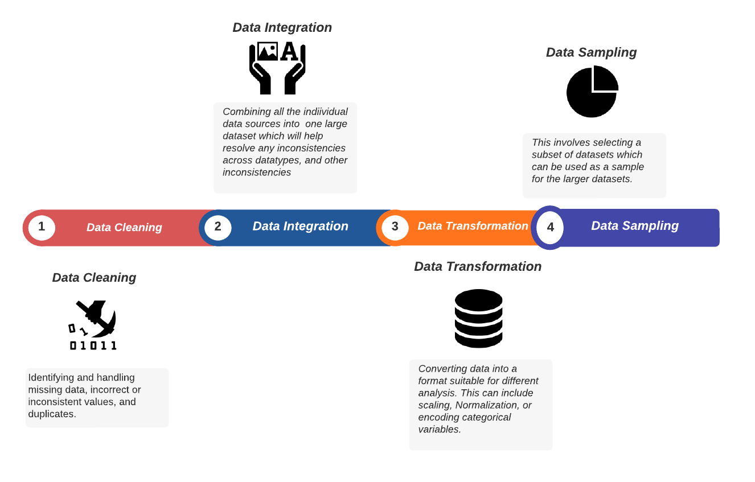
Data Pre-processing

Slide 11
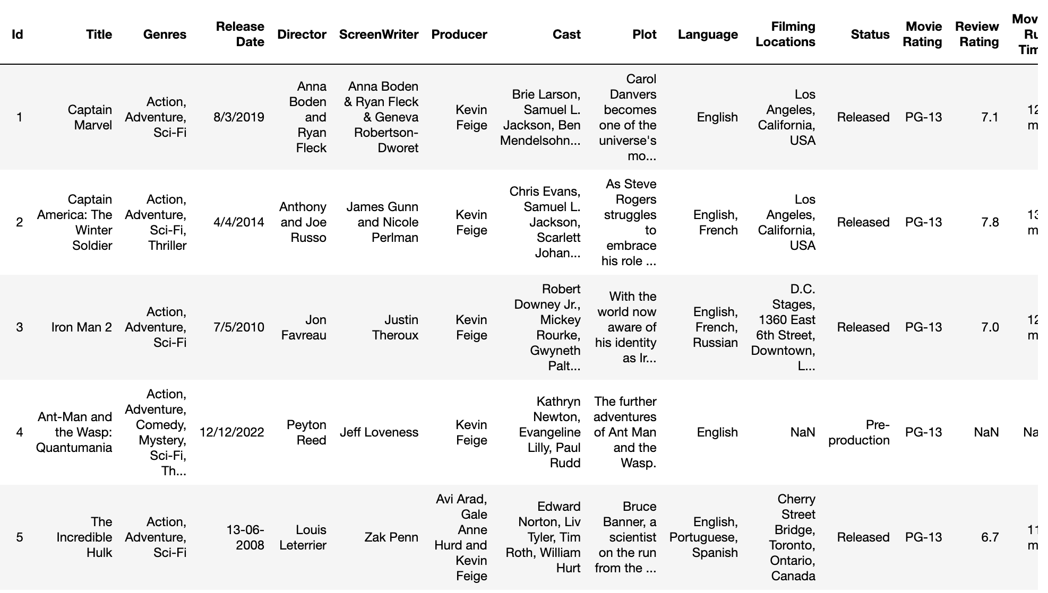
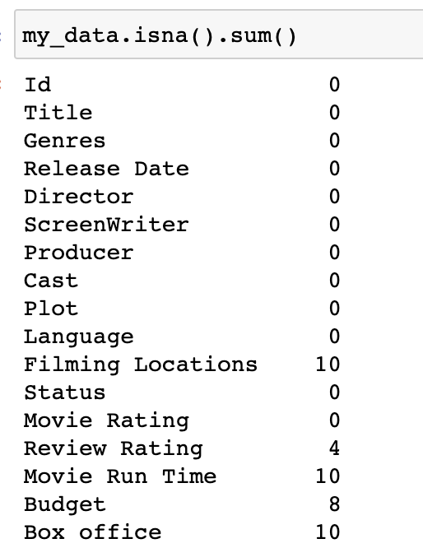
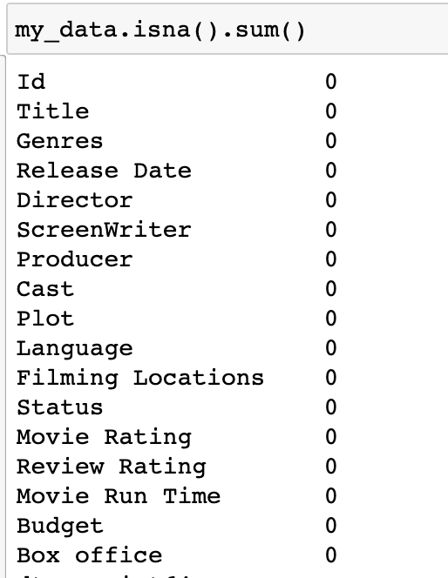
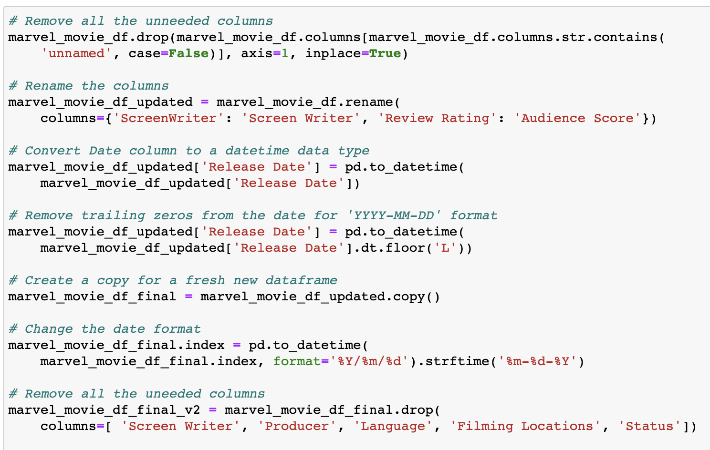
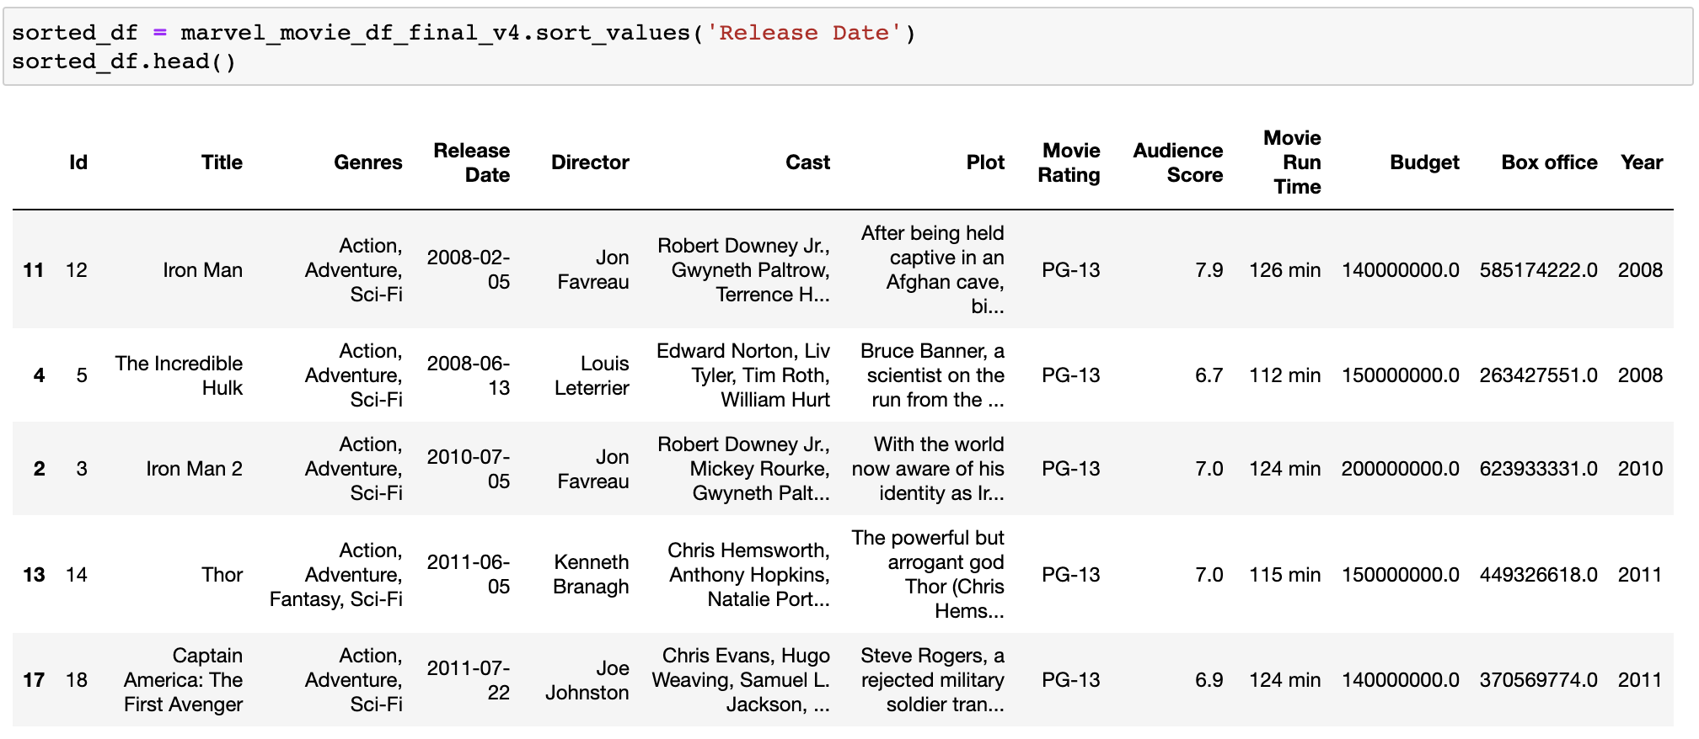
Before data cleaning
Data Cleaning
Before handling null values
After handling null values
After data cleaning
Data cleaning

Slide 12
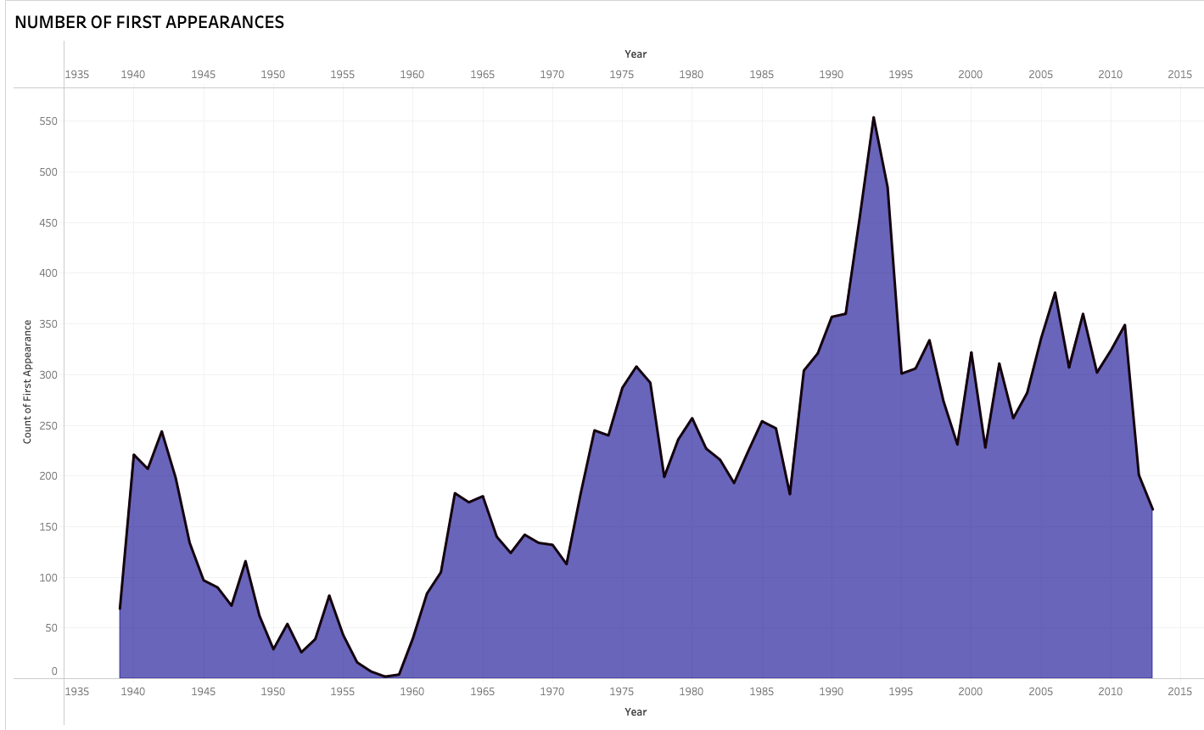
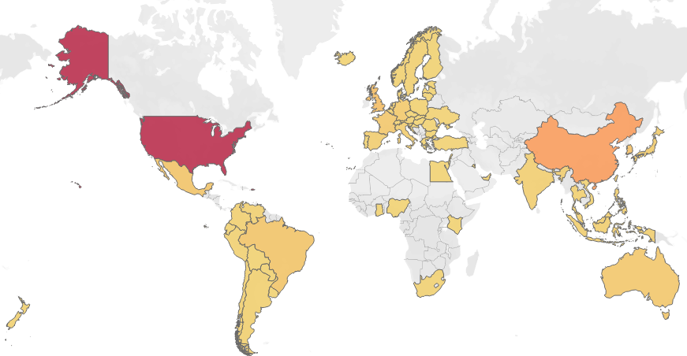
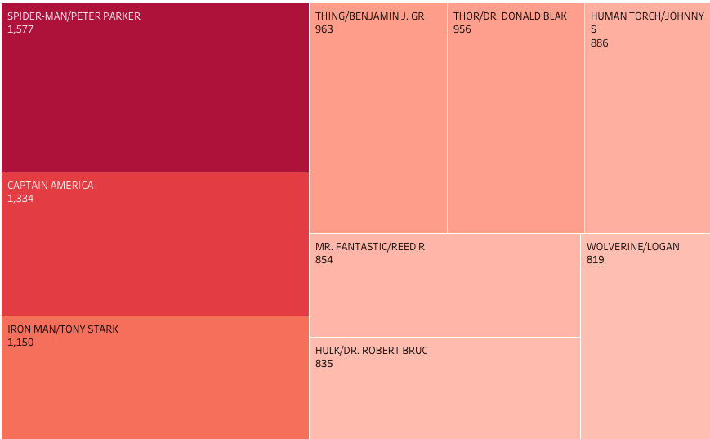
Exploratory Data Analysis
Box office collection World wide
US has the most marvel fans w.r.t box office record followed by China
A lot of Characters were introduced between 1990 - 1995
Spider-man(Peter Parker) is the most popular Marvel character. Followed by Captain America and Iron Man.
Character Popularity Analysis

Slide 13
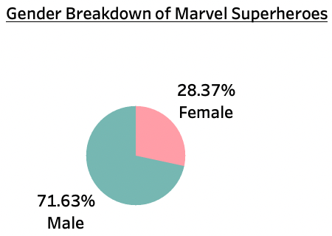
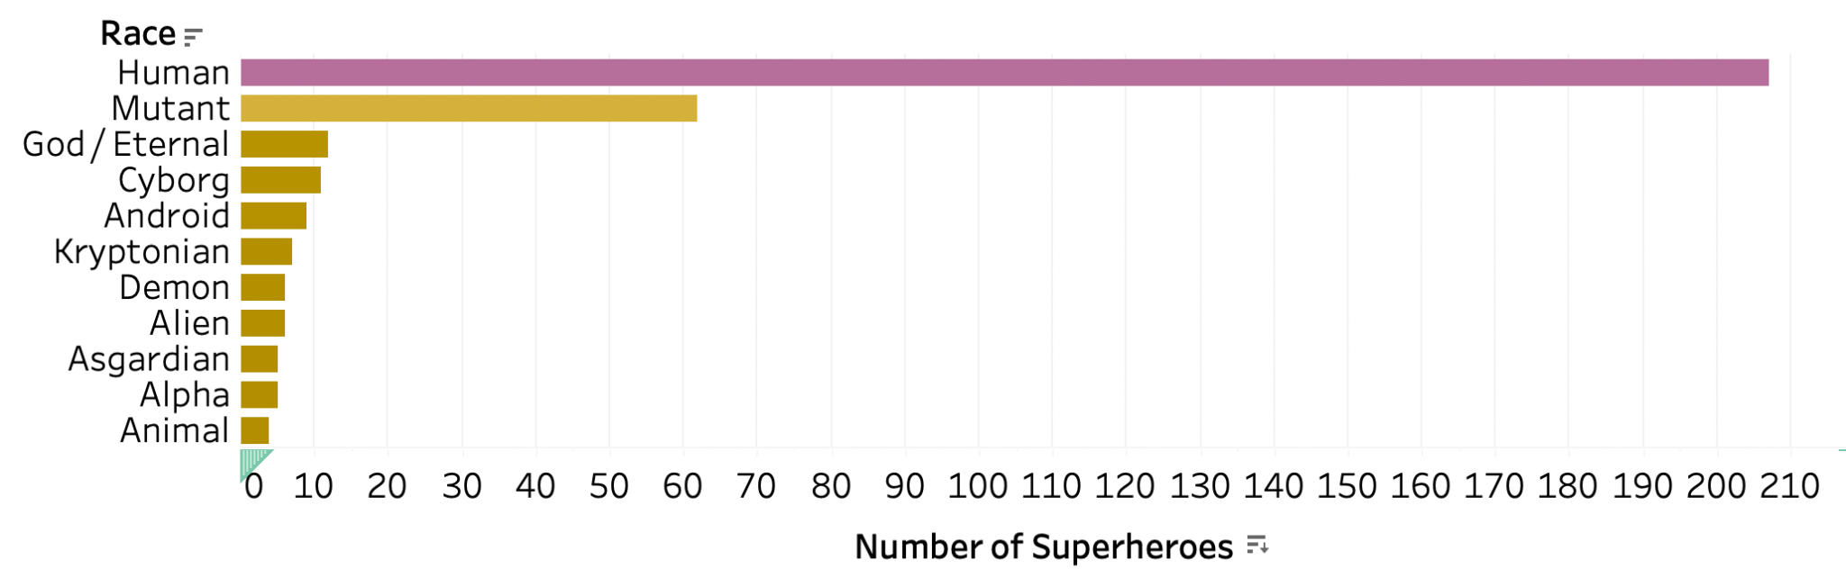
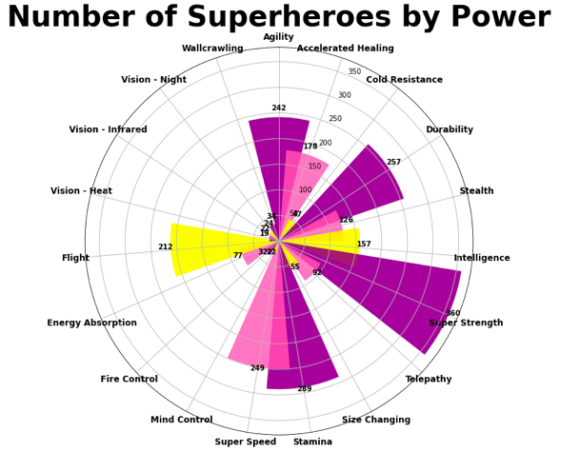
Exploratory Data Analysis
Gender Breakdown
Race Representation
Male superheroes are more prevalent than females
Super Strength is the most common ability
Humans are the most common superheroes in Marvel.

Slide 14
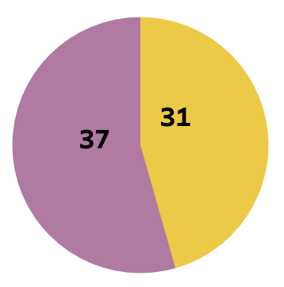
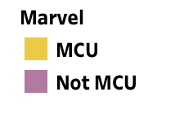
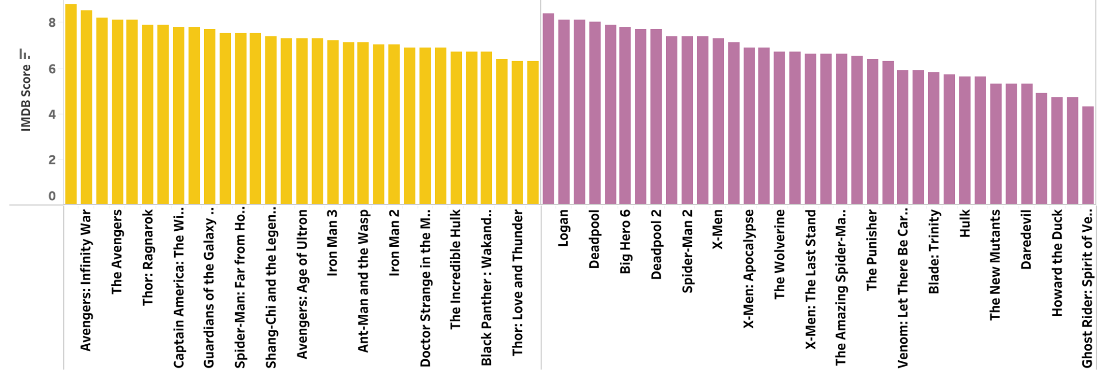
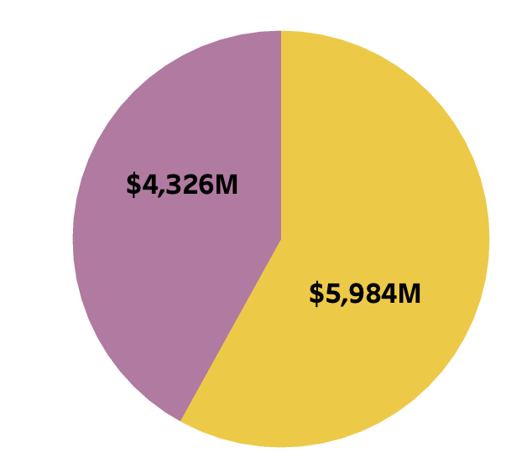
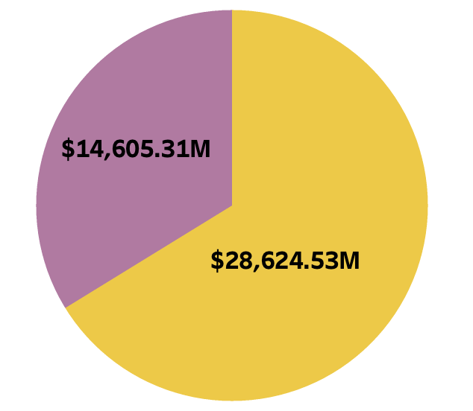
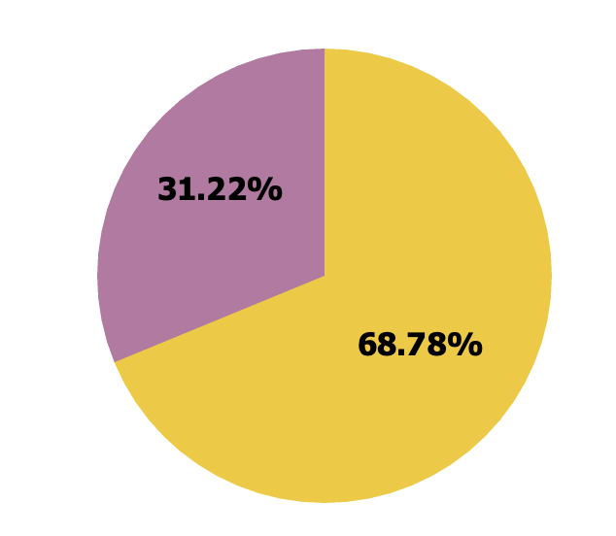
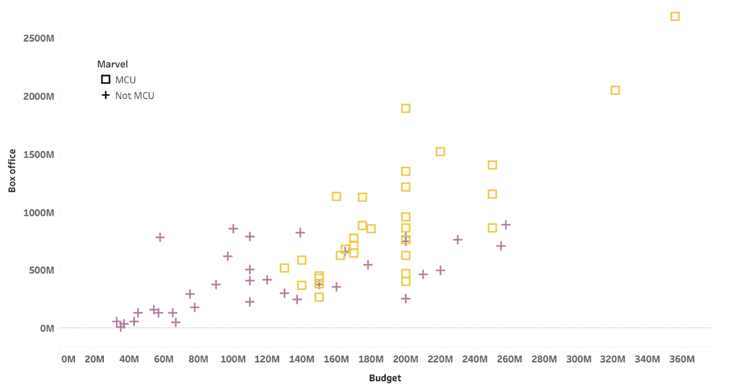
Exploratory Data Analysis
Budget
No. of Movies
Non-MCU movies are more than MCU movies
The total Budget,box-office collection of MCU movies is more non-MCU movies
The profit of MCU movies are almost 2x of non-MCU movies
There is a linear correlation between the budget and box-office
Box-office
Profit

Slide 15
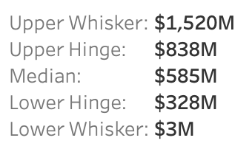
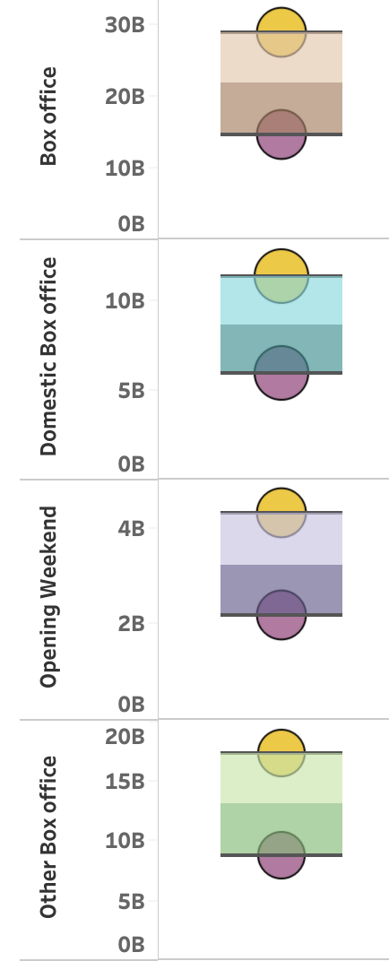
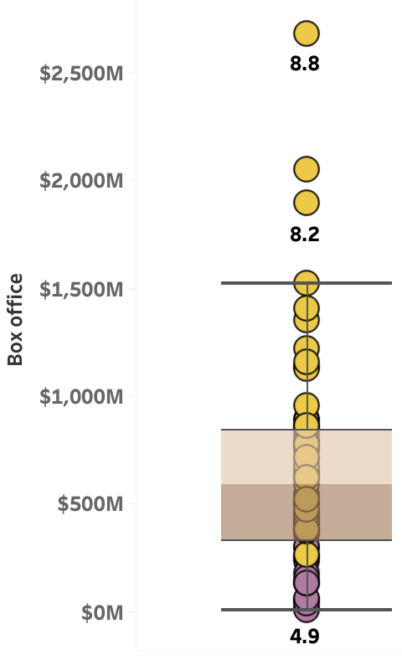
Exploratory Data Analysis
Almost all MCU movies fall above the mean box-office collection and non-MCU movies fall below. The trend of box-office collections distribution also applies to domestic box-office collections, other territories' box-office collections, and opening weekend collections.
The MCU movies hold the record for the highest box-office collection, while non-MCU movies have the lowest box-office collection record.
The MCU movie Avengers: Endgame has the highest box office collection with an IMDB rating of 8.8 and the non-MCU movie Inhumans has the lowest box office collection with an IMDB rating of 4.9

Slide 16
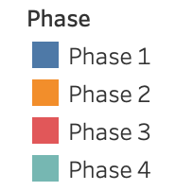
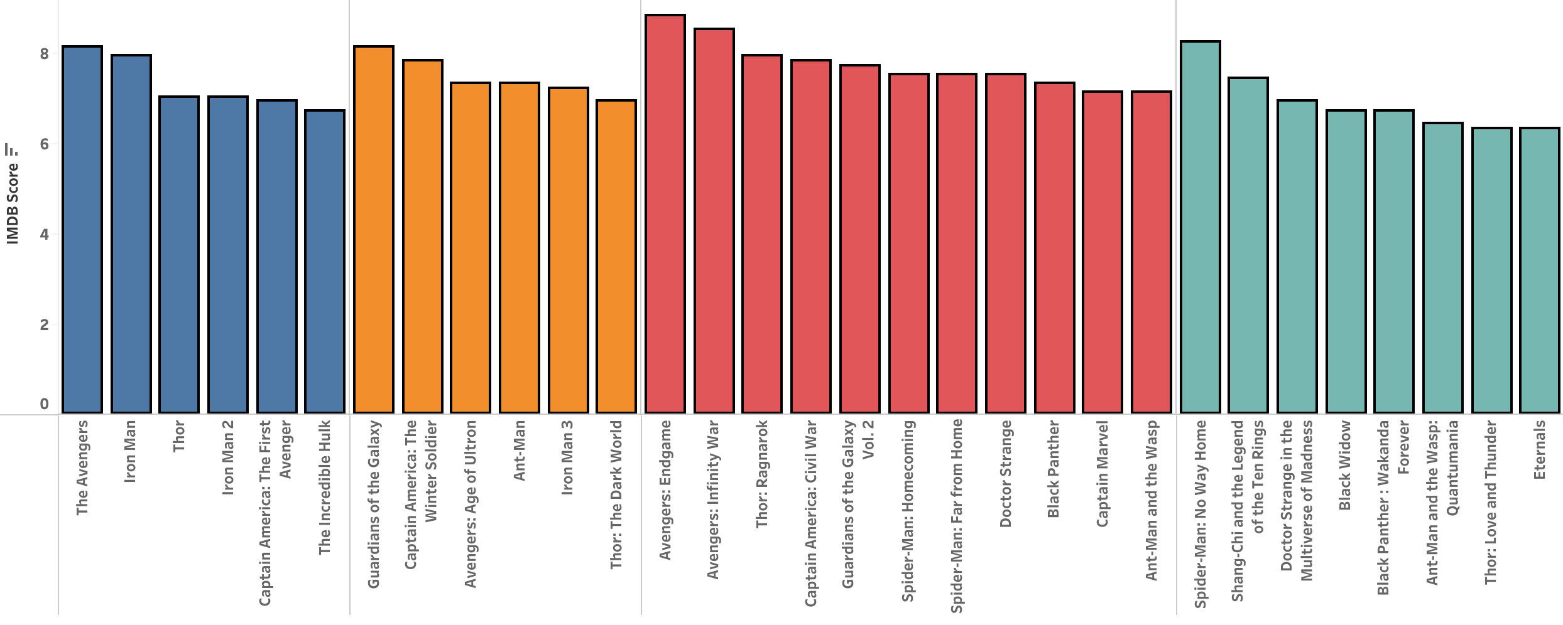
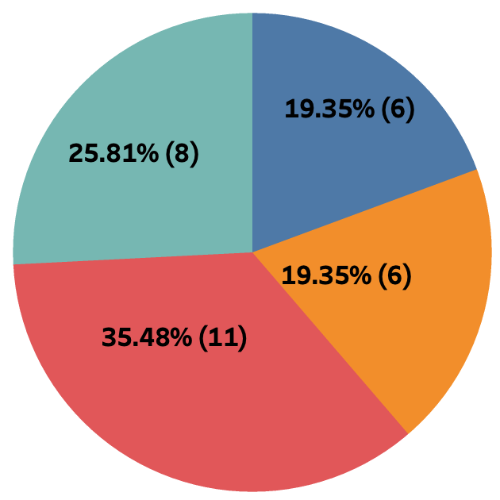
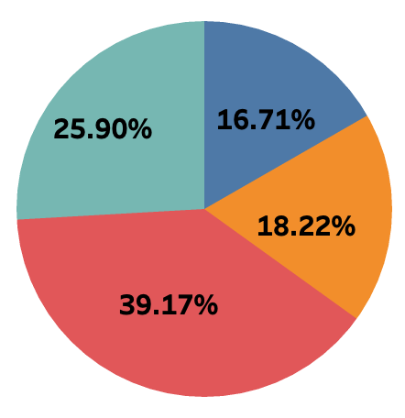
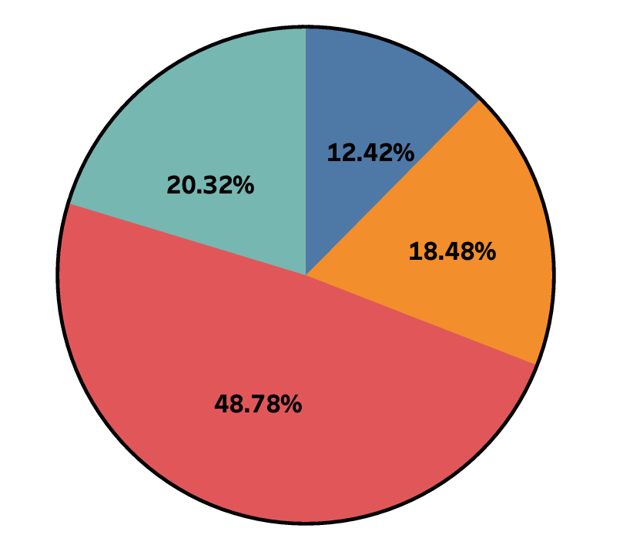
Exploratory Data Analysis
No. of Movies
Budget
Profit
The number of movies released in Phase 3 is more than that of Phase 4 > Phase 2, Phase 1
The Total Budget of Phase 3 is more than that of Phase 4 > Phase 2 > Phase 1
The Total profit of Phase 3 is more than that of Phase 4 > Phase 2 > Phase 1
We can also see the IMDB scores for each movie

Slide 17
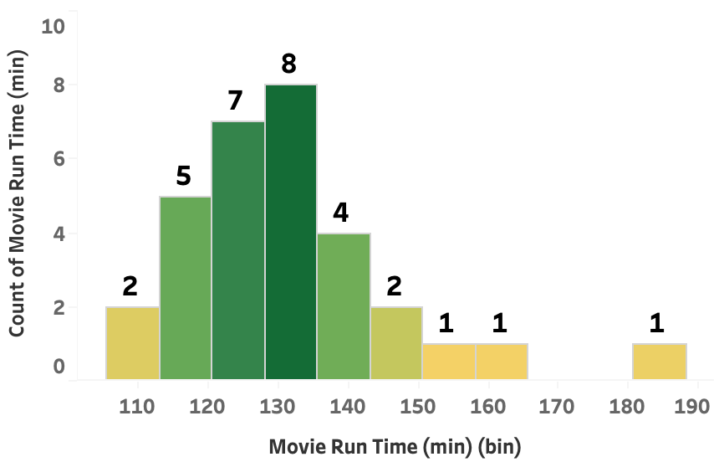
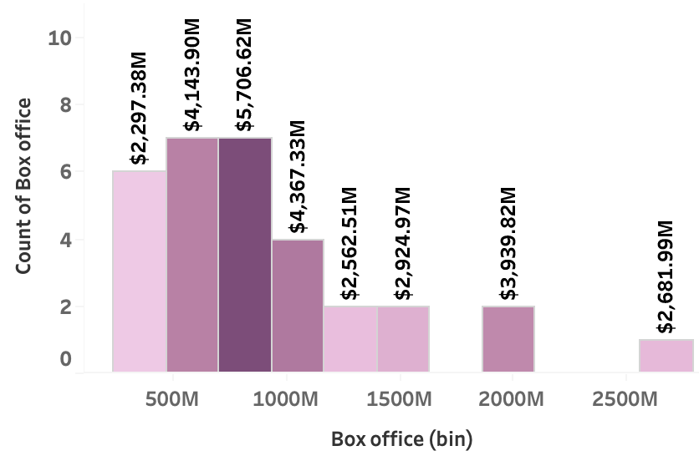
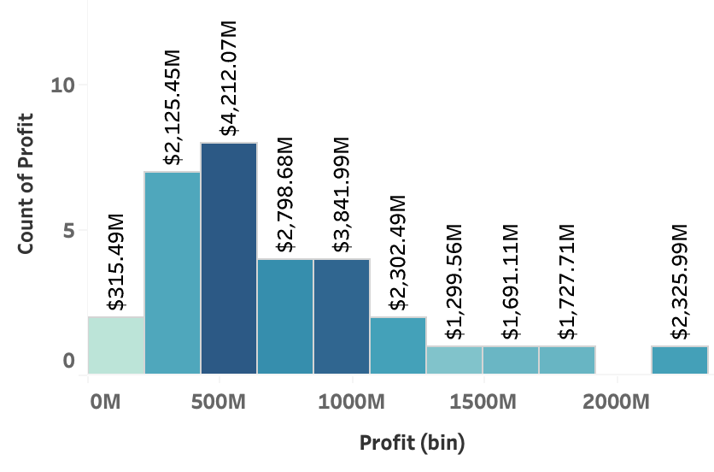
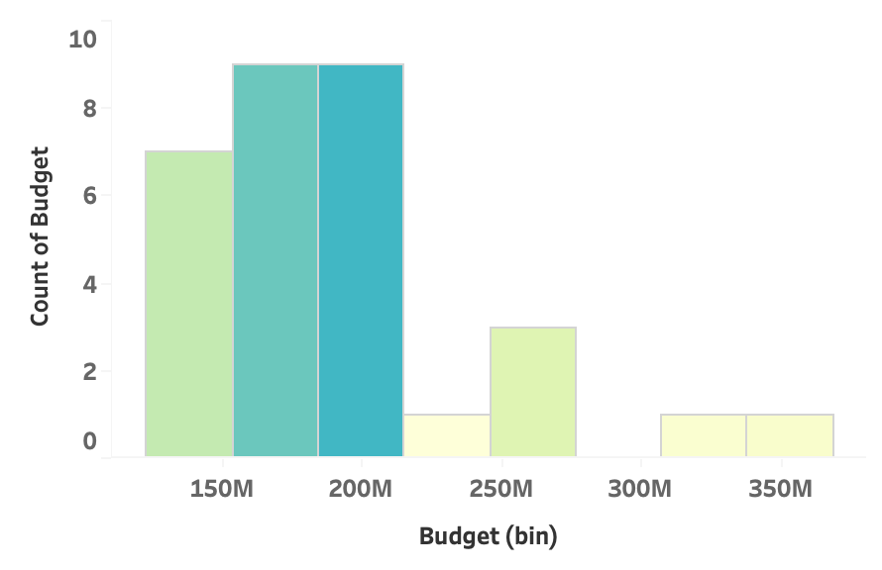
Exploratory Data Analysis
Most of the movie budget is between 150M - 200M , Very less movies had higher budget which is above 300M
Most of the movies box-office collections (7) were between 500M - 1000M.
Most of the movies (8) made a profit of 500M and there was one movie which grossed 2325M profit
Most of the movies (8) movies have a run time between 130 - 135 min, there are very few long running movies which goes behind 190

Slide 18
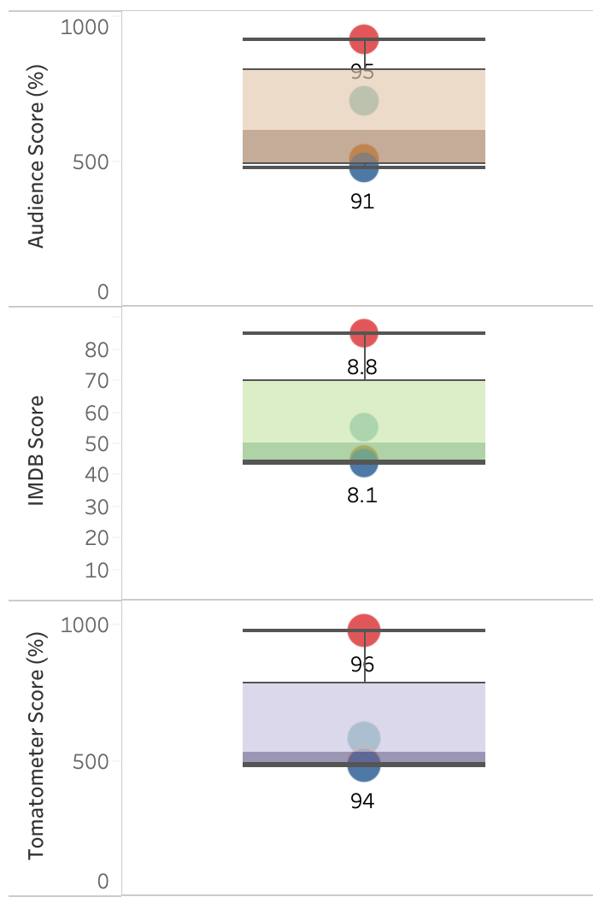
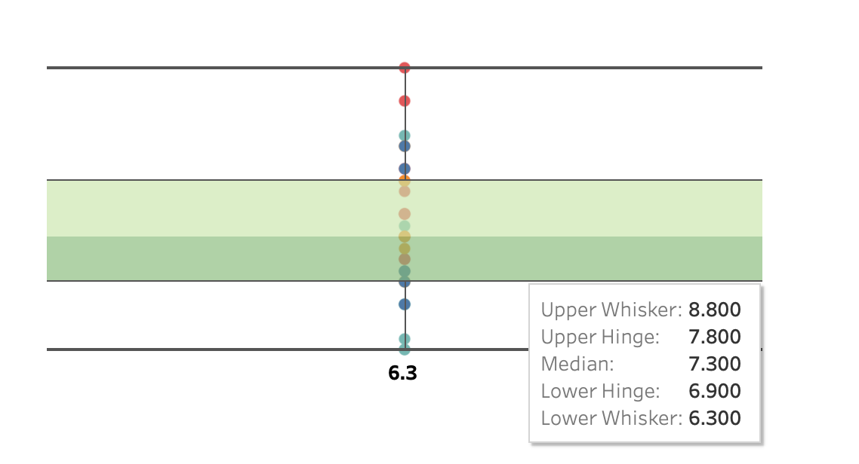
Exploratory Data Analysis
The distribution indicates that Phase 3 had the best Marvel movies with highest Audience, IMDB and Tomatoes score.
Phase 4 which is ongoing has the second highest Audience, IMDB and Tomatoes score
The first Phase of MCU had the least Audience, IMDB and Tomatoes score.
The highest IMDB rating is 8.8 and the lowest being 6.3. The Ratings are however seen distributed across the range
IMDB Distribution

Slide 19
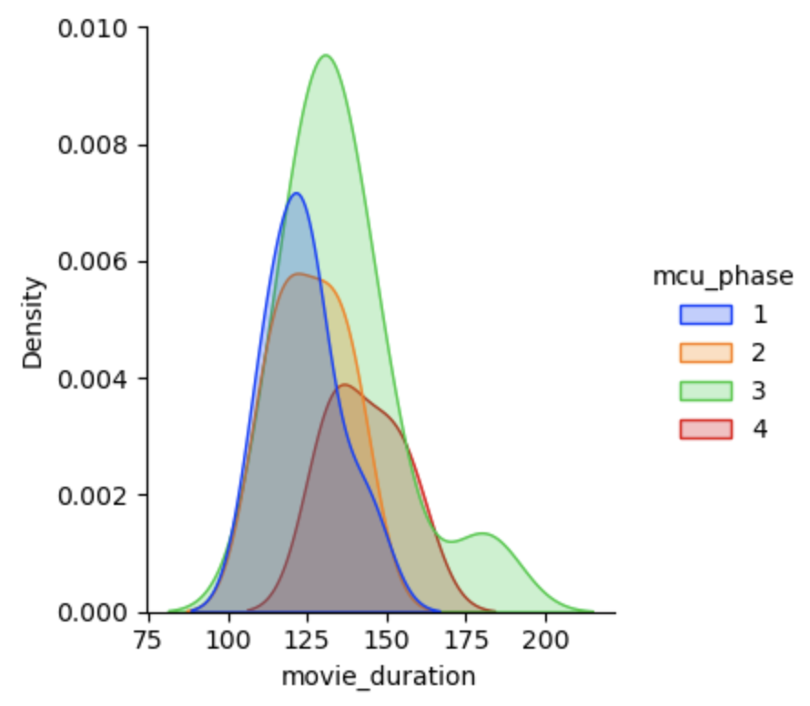
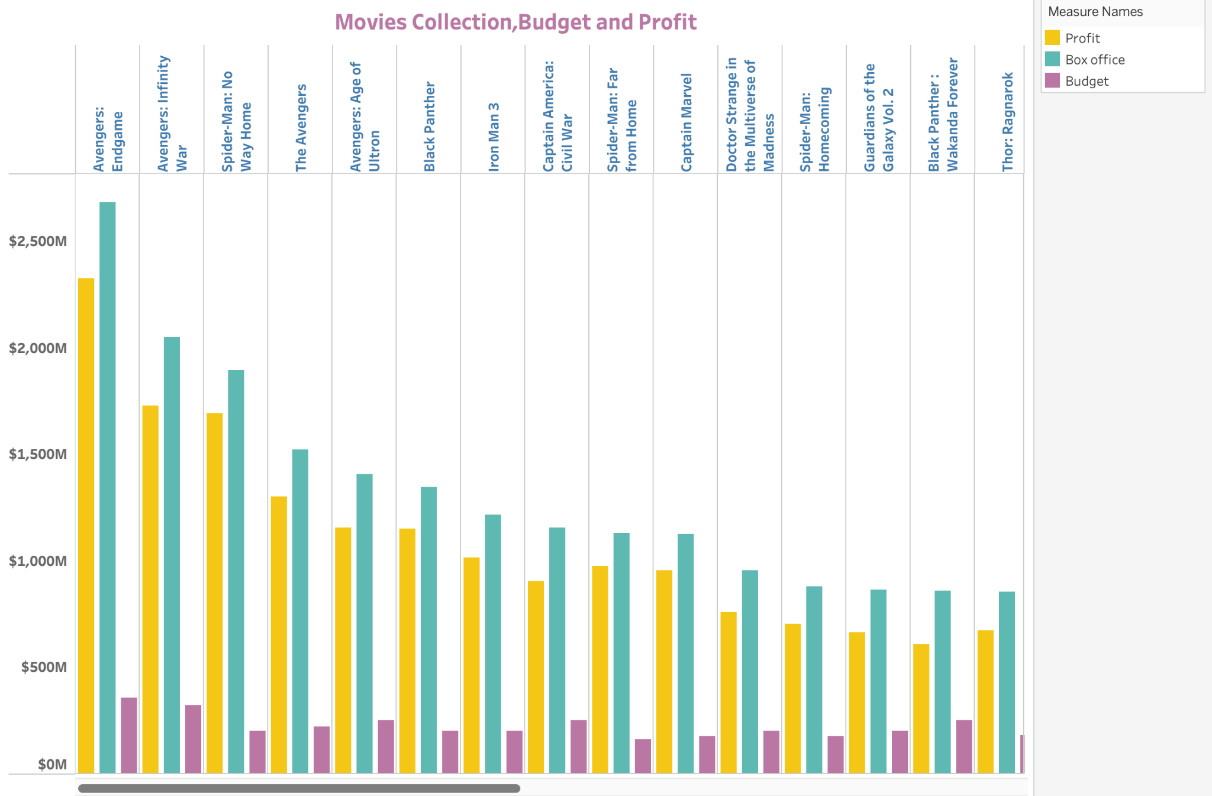
Exploratory Data Analysis
Movie Runtime Distribution w.r.t Phase
Detailed Budget, Box office and Profit of each Marvel movies. Avenger End game tops the Marvel game
Phase 3 movies have a longer run time when compared to Phase 1 > Phase 2 > Phase 4
Budget, Box-office and Profit details of all MCU Movies

Slide 20
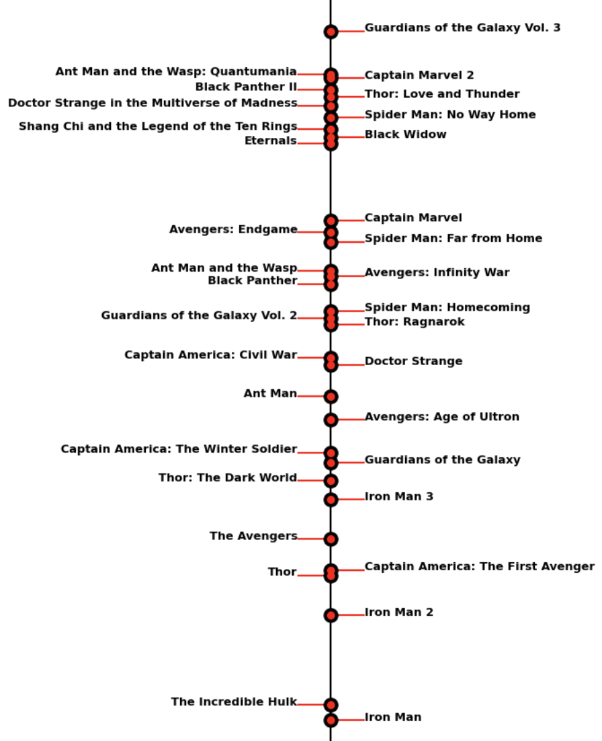
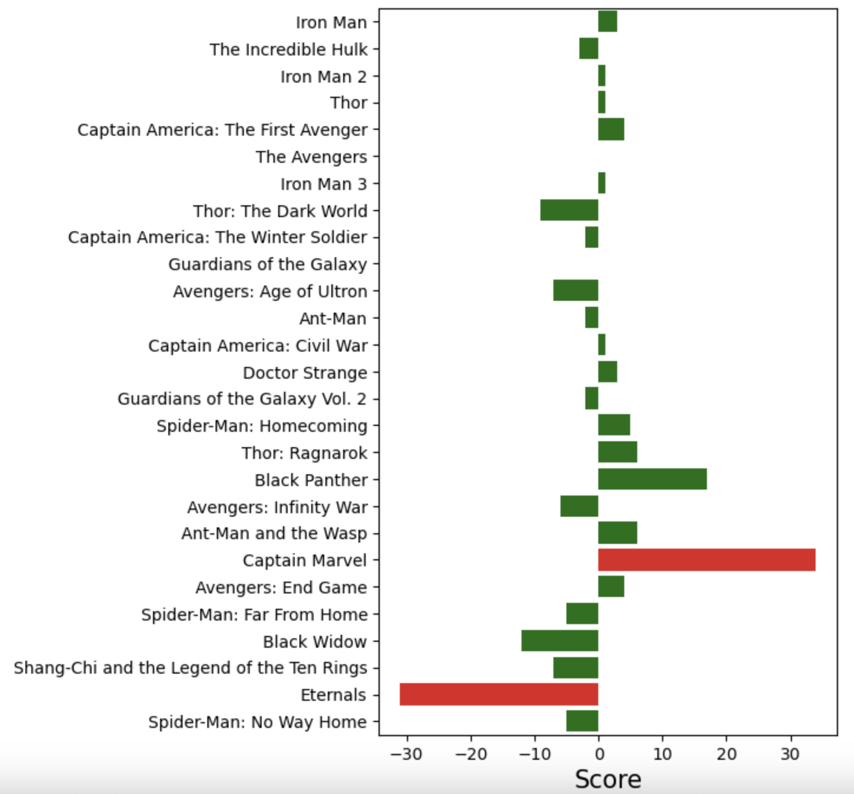

Exploratory Data Analysis
Difference in scores between the Rotten Tomatoes critics and the audience for each Marvel movie. Positive values indicate a higher score from the critics, while negative values indicate a higher score from the audience.
Movie Timeline: A Marvel Fan's Guide to Understanding the Chronological Sequence of Movies
Score Difference between Critics and Audience
MCU movies timeline to aid Marvel Fans

Slide 21



Exploratory Data Analysis
The dataset exhibits a gender imbalance, with a higher representation of male characters categorized as good, bad, and neutral compared to females. Additionally, there are limited agender characters and one genderfluid character present.
Good characters are tall and lightweight, bad characters are larger in size, and neutral characters have moderate height and weight.
The most common bad character is Norman Osborn, good character is Spider-man, neutral character is Scott Summers.

Slide 22

Marvel Universe Data Hub: A Dynamic HTML5 and Bootstrap Dashboard

Slide 23




Data-Driven Audience Survey Analysis: Valuable Insights for Marvel Writers
The data suggests that diversity and representation in Marvel productions is an important topic to a significant portion of the surveyed population
The majority of respondents find it somewhat important, but not a priority, for Marvel stories to tackle relevant current social and cultural issues.
Marvel Audience prefer complex and dynamic team dynamics, friendships, rivalries, and conflicts in favorite Marvel character relationships
"Rarely" had the highest count for the question "How often do you read Marvel comics?", being 1,750.00% higher than the lowest response, "Daily".
Social and cultural Issues
Marvel comics Reading Frequency
Diversity Representation
Favorite Marvel Character Relationships and Dynamics

Slide 24




Data-Driven Audience Survey Analysis: Valuable Insights for Marvel Writers
Iron Man is the most popular superhero among the surveyed population, followed closely by Spider-Man, providing insight into the top superhero choices of fans
.
Thanos was the most interesting Marvel villain based on the survey responses, while Red Skull was the least interesting.
Doctor Strange was voted as the Marvel movie with the best visual effects with the highest count compared to other movies.
The respondents were moderately satisfied with the current state of the Marvel Cinematic Universe content.
Favorite Marvel SuperHero
Favorite Marvel Villain
Best Visual Effects
Marvel Satisfaction Rate

Slide 25




Data-Driven Audience Survey Analysis: Valuable Insights for Marvel Production
Many respondents are interested in visiting marvel themed attractions but they have not visited yet. Few people who have visited the themed attractions have enjoyed the experience.
There are many people interested in marvel themed events if it is planned in the future.
Survey respondents were satisfied with movies and are likely to suggest them to others.
Many people have purchased merchandise from marvel. T-shirts and posters are the main merchandise purchased by survey respondents.
Experience with Marvel Themed attractions
Interest in marvel themed events
Likelihood of recommending marvel productions
Marvel Merchandise Purchase History

Slide 26


Data-Driven Audience Survey Analysis: Valuable Insights for Marvel Production
Spider man across the spider verse and Guardians of galaxy volume -3 are most anticipated future movies of marvel based on survey.
Action, special effects, characters and their stories are favorite aspects of marvel movies among survey population.
Most anticipated upcoming marvel movie
Favorite aspects of marvel movie production

Slide 27


Data-Driven Audience Survey Analysis
Marvel Hero Network
Plot suggests survey respondents who are interested to view marvel movies through both theater and streaming service mostly open to the idea of watching movies through alternative media like virtual reality.
But people who watch marvel movies only through streaming service are comparatively less interested in trying other media experience.
The depicted plot illustrate the superhero network based on their occurrences. From the diagram, it is evident that Captain America emerges as the most connected superhero within the Marvel Productions. Other notable MCU heroes such as Spider-Man, Iron Man, and few others also exhibit significant connections within the network.

Slide 28
Conclusion
Future scope of work
We have successfully utilized various data visualization tools and techniques from bar charts and pie charts to 3D scatter plots and network graphs to visualize the Marvel fan ecosystem.
By exploring different aspects of the Marvel Universe, we gained insights into the financial success, character traits, popularity, and audience reception of these iconic movies and characters.
We have uncovered interesting patterns and trends that can help businesses and marketers better understand and engage with Marvel fans.
By applying advanced analytical techniques, we aim to uncover deeper insights and patterns in fan preferences, engagement, and purchasing behavior.
We plan to expand our data sources beyond the current dataset to include additional Marvel-related sources.
While our current focus is on the Marvel Cinematic Universe, we aspire to explore other franchises within the entertainment industry.
Our data visualization journey is an ongoing and dynamic project. This ongoing effort ensures that our project remains up-to-date and relevant in an ever-evolving entertainment landscape.

Slide 29
Questions?
Thank You, Avengers!!

